Slide 1

LKK MOBILE STORE PROJECT
Group 7:
Pham Van Khoa
Le Duc Long
Nguyen Manh Khang

Slide 2
Introduction
LKK Mobile Shop
Online store system is our way of accessing customers through the internet
Our system has full product information that is regularly updated and supports online purchases in the most effective way for customers
Customer can choose one or more items to place an order which will land in the cart
Customer can view all the order details in the cart before checking out and get all information to confirm at the end

Slide 3
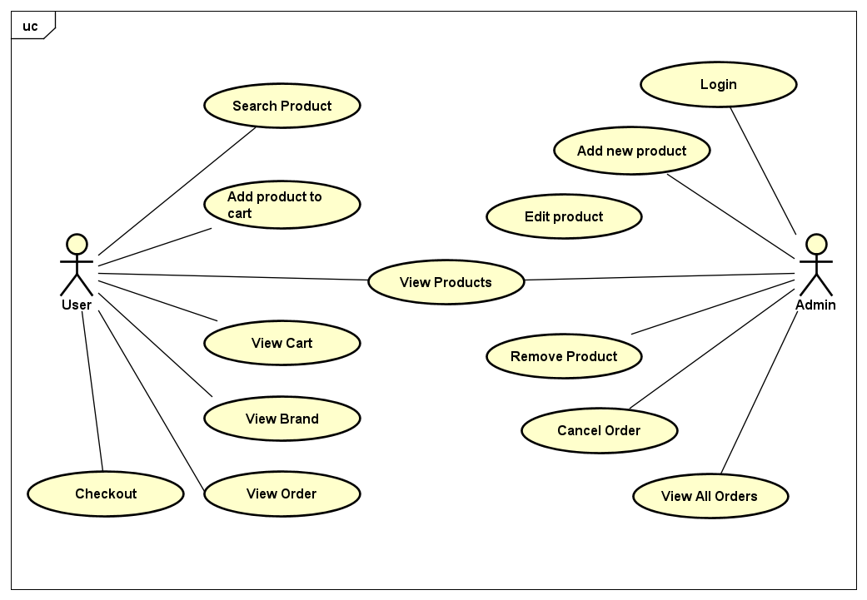
USE CASE
Notes:
//TODO

Slide 4
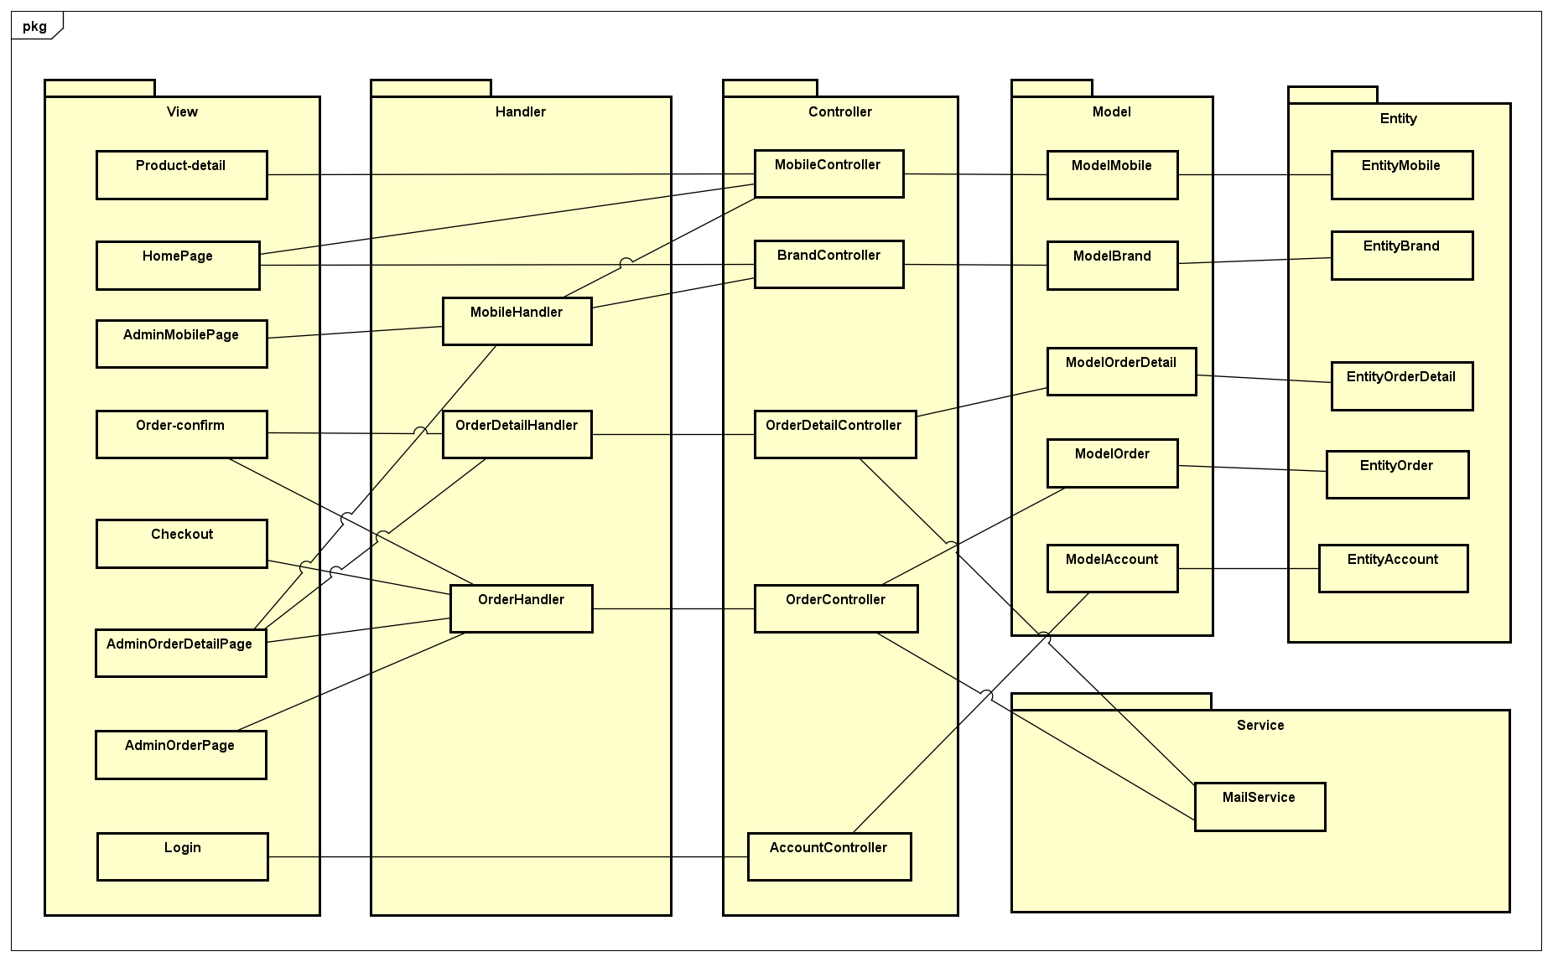
CLASS DIAGRAM
Notes:
//TODO

Slide 5
DATABASE
5 tables: Account, Brand, Mobile, Order, Order detail
Account table has id, username, password
Brand and Mobile storage all information of any brand and any mobile respectively
Order contains information of carts, customers and their bills
Order detail table has id, order id, mobile id and quantity which contain the information of mobiles in an order

Slide 6
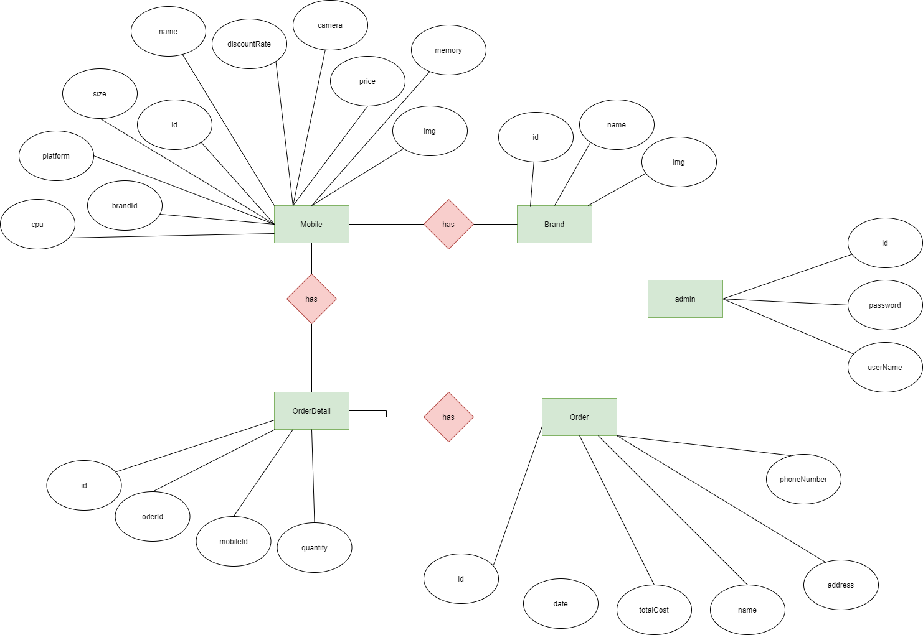
ER DESIGN

Slide 7
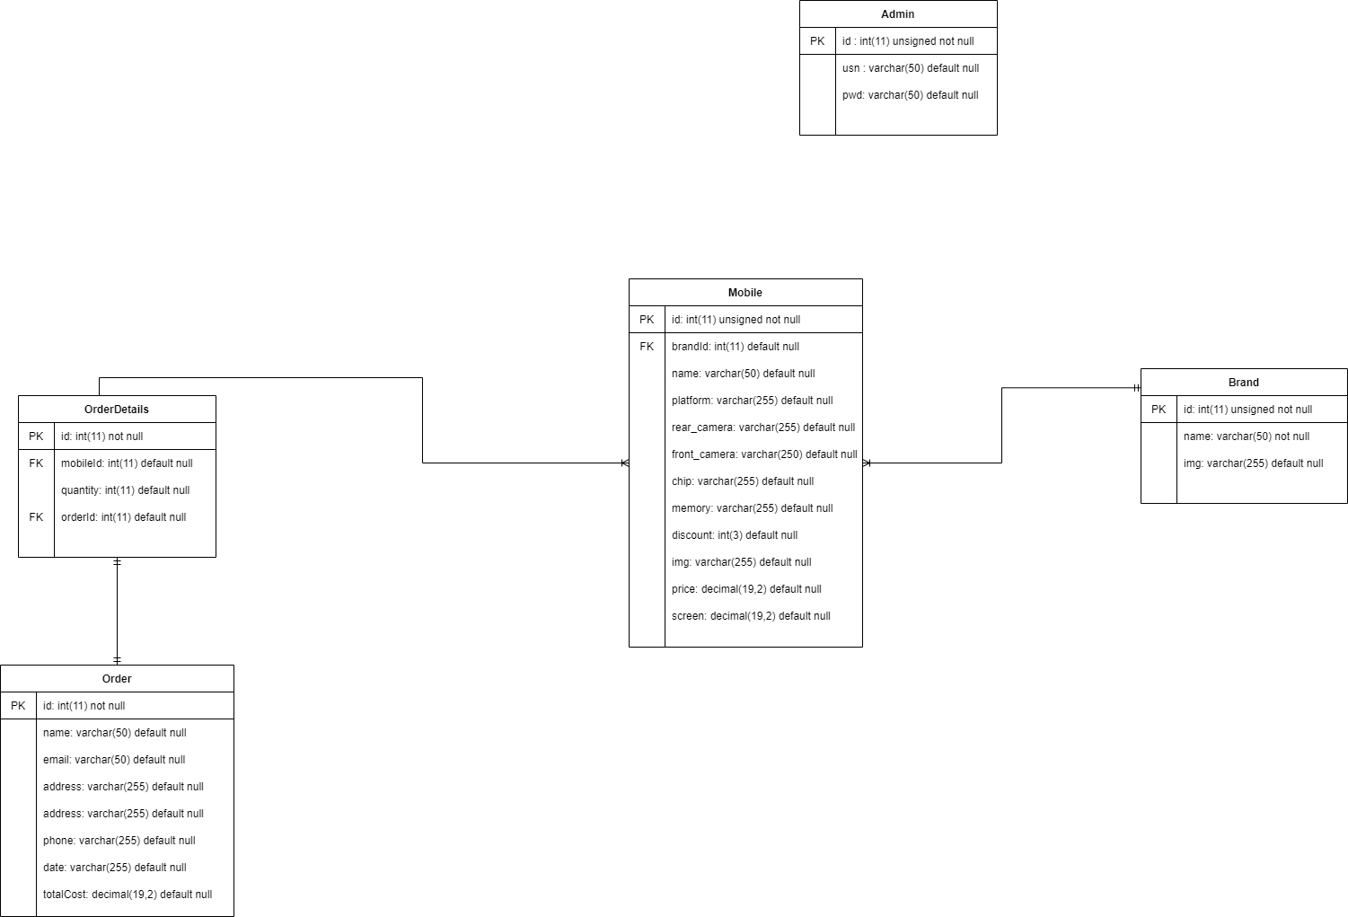
DATABASE DESIGN

Slide 8
TECHNOLOGY
Database: MySQL
Front-end:
HTML
CSS
JS
Back-end:
WampServer
PHP

Slide 9
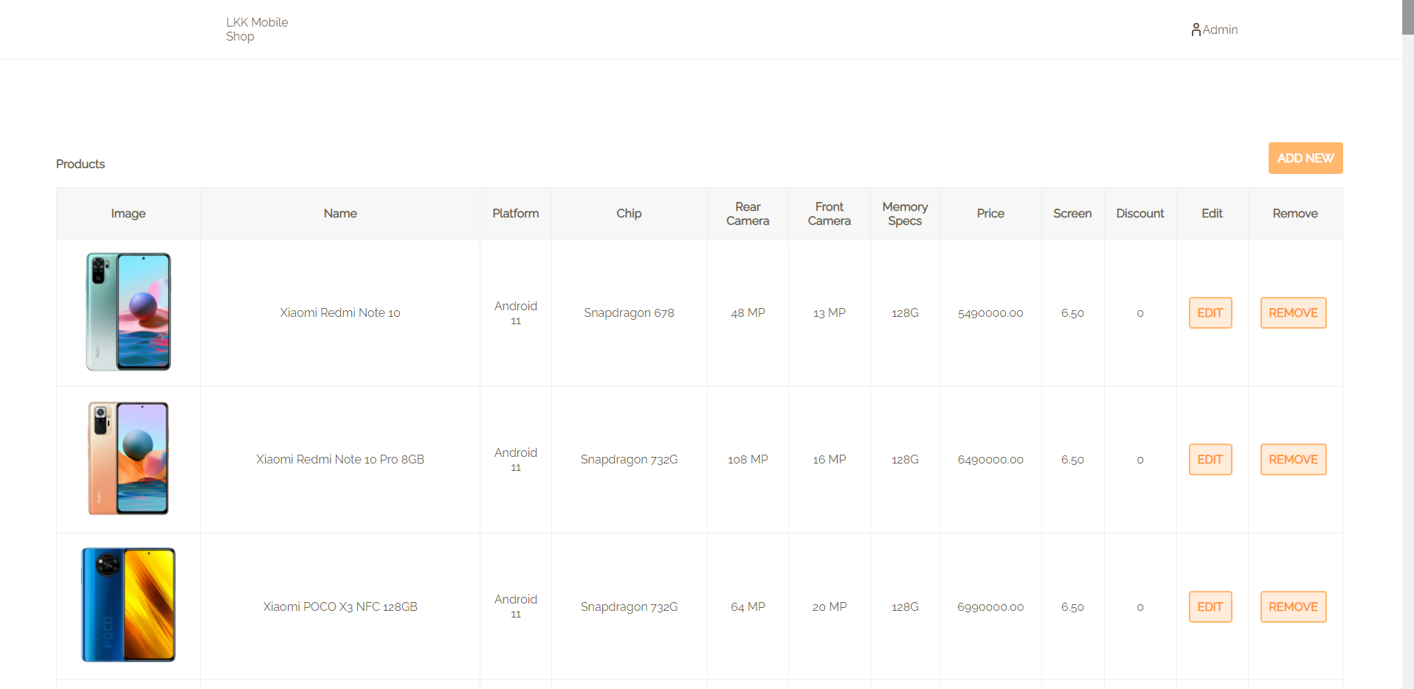
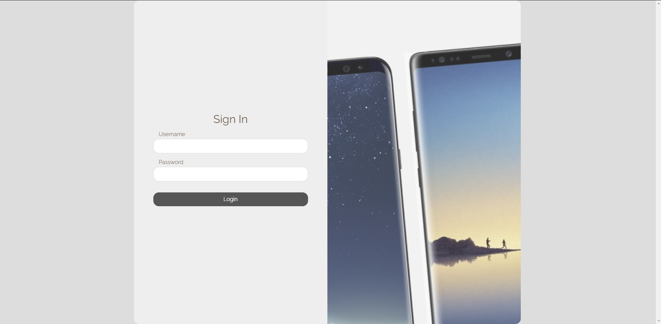
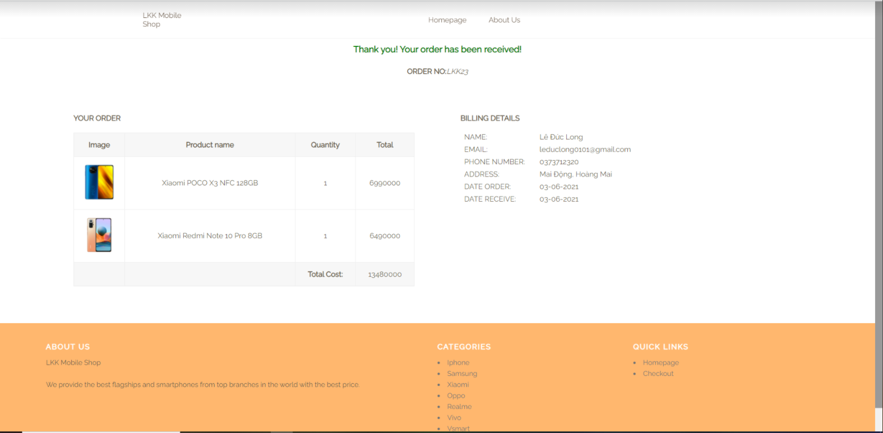
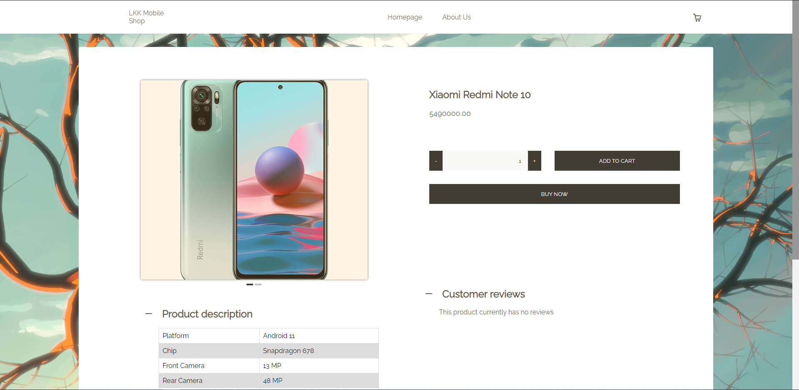
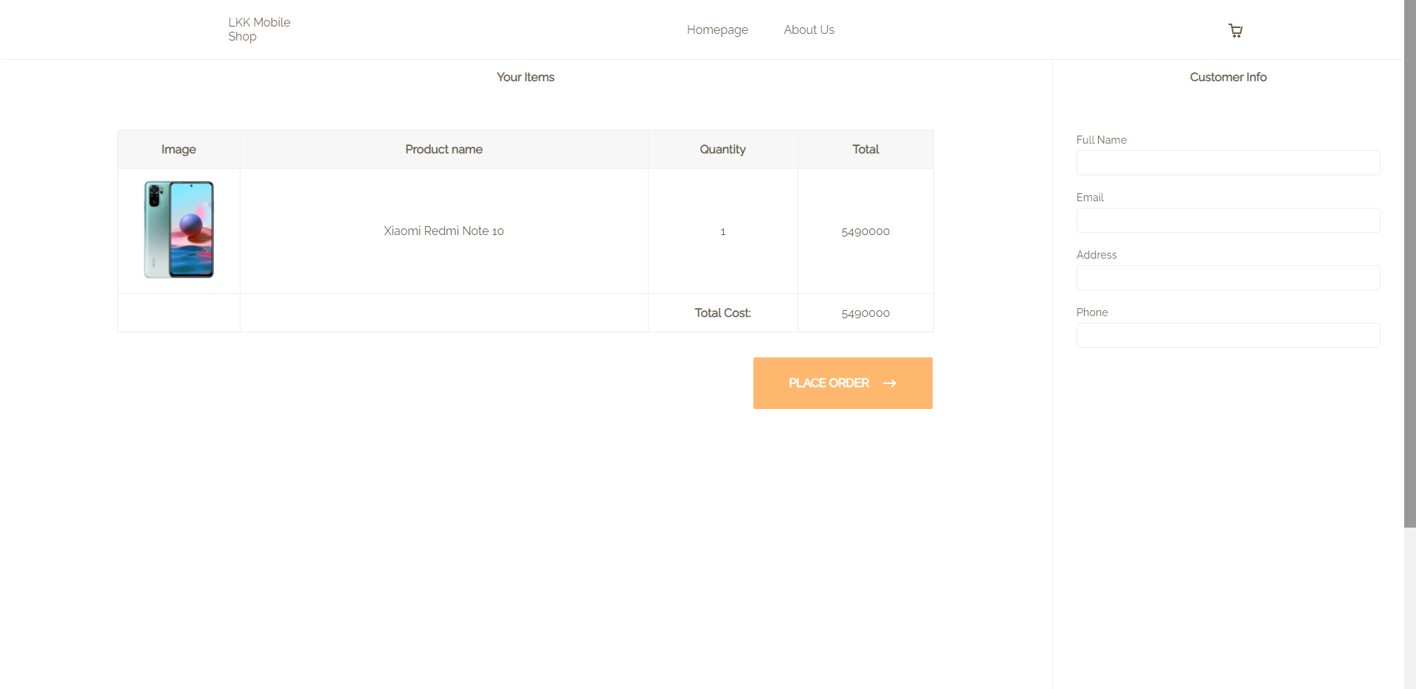
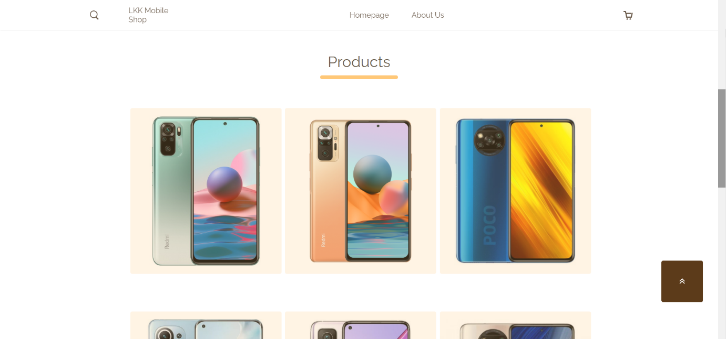
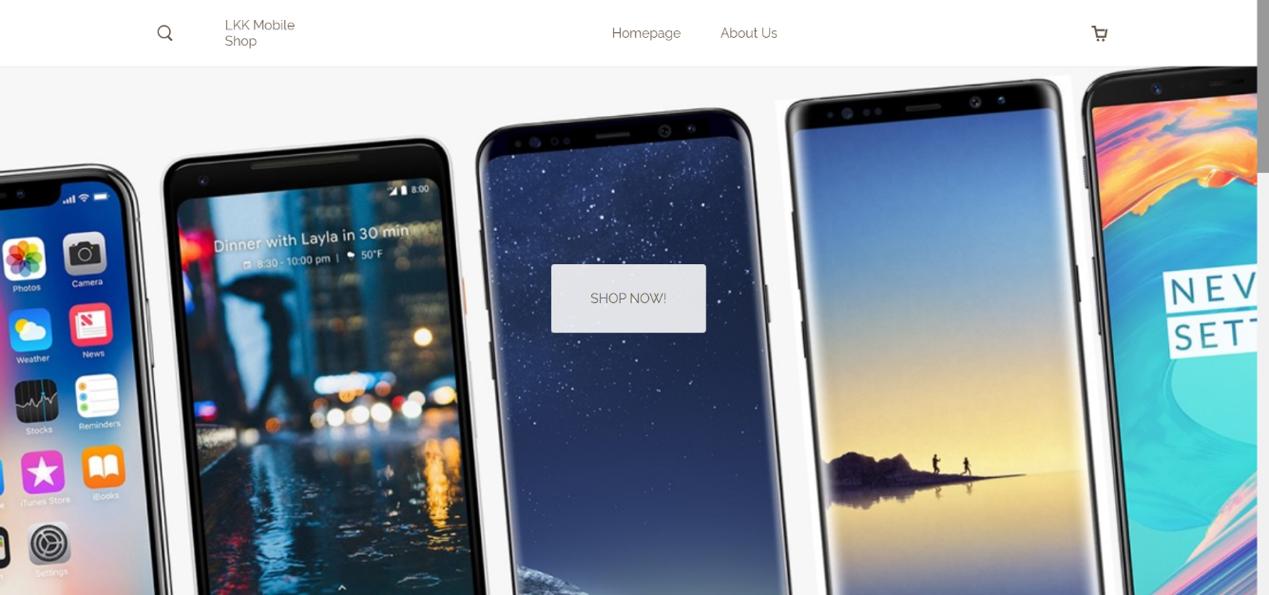
RESULT
Notes:
//TODO

Slide 10
DIFFICULTIES
All members are new to Web development( new to PHP, JS, CSS without bootstrap,…).
Since we are all new to the task of developing a fully functional website, the time given is not as enough as we expected.
Too many deadlines at the end of semester.
Have to work online due to COVID- 19, which makes communication between team members become more difficult.

Slide 11
LESSON LEARNED
Improve web design thinking.
Better understanding of HTML CSS JS PHP,…
Improve teamwork skills.
Constantly work on the project throughout the semester.
Improve self-study skills and work independently.

Slide 12
WORK CONTRIBUTION

Slide 13
CONCLUSION
The final result does meet most of our expectations.
All members did their best for the highest result of the final product.
We learn many valuable lessons and knowledge from this course.
Sincerely thanks to our devoted professor for his detailed lessons and most importantly his enthusiasm throughout the course.

Slide 14
THANK YOU FOR LISTENING

